Slide 1

Emergency plan instructions
September 2019

Slide 2
Contents
Purpose
Types of calamity
Duty to report
Alarm signal
Alarm phases
Positions in the emergency organisation
Carrying out tasks
Code Of Conduct

Slide 3
Purpose
At Yara Sluiskil, a preventive policy is implemented to prevent calamities. If, despite everything, a calamity nevertheless occurs, Yara Sluiskil and its emergency organisation want to limit the calamity to a minimum – if necessary – in cooperation with the local government.
Acquiring basic knowledge of the emergency plan.
Notes:
We are a company that falls under the BRZO (or Seveso), and in that context we are obliged to have an in-company firefighting team at our location.
In addition, the Working Conditions Act states that we must have an emergency organisation. Yara’s solution to this is further explained in the following slides.
BRZO = Major Accidents Risks Decree

Slide 4
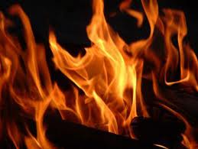
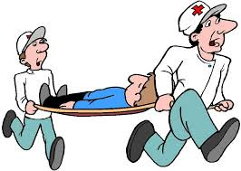
Types of calamity
Fire
Fire caused by burning and accompanied by flames, capable of reproducing itself.
Accident with hazardous substance
An event, such as a major emission or an explosion, associated with an unusual occurrence in an industrial activity, presenting a serious hazard, immediate or delayed, to people inside or outside the establishment and/or to the environment, and involving one or more hazardous substances.
Accident with injury
A sudden event that causes a person to have a physical injury or even causes death.
Notes:
Fire
Accident with hazardous substance
This is typical firefighter jargon, which means that there is e.g. a leak/emission of nitric acid, ammonia or hydrochloric acid
Accident with injury
This is firefighter jargon for an accident. This includes FAC, MTC, RWC and LTI.
MTC = Medical Treatment Case
RWC = Restricted Work Case
LTI = Lost Time Incident

Slide 5
Duty to report
Every employee has a duty to report a life-threatening event, accident, fire or serious leak immediately.
Attention:
It is not allowed to use the emergency number as a ‘normal’ phone line
How?
In case of a fire, press the fire alarm button and call the emergency number or call the emergency number immediately.
  100 or (F1) 100 with a landline or call 0115 474 100 with your mobile.
  Briefly state:
    who you are;
    what happened;
    where it happened;
    any consequences inside and/or outside the department/company.
  If it is not a fire, do not use the fire alarm button but call the emergency number.
Notes:
The law says that everyone has a duty to report what they see in life-threatening events. This can be an accident, a big fire, a leak, an emission in the air, etc.
Our emergency number can be called at any time with any device on site. A mobile phone can also reach it, but then you will have to type in the full number!
Stay calm and try to give security as much information as possible.
E.g. My name is ..., I am in Reforming C in the machine hall and there’s a fire.
If possible, you should also state whether it is a small or a big fire, so security is able to assess if they need to declare an alarm phase 1 right away instead of starting with alarm phase 0.
If you press a fire alarm button, it is important that you call 100 as soon as possible to give more information. If there is no phone nearby, walk to an intercom and pass it on that way and ask for them to call 100.
The report of a fire comes in at the security department and they will start the fire alarm. For as long as there is no additional information, the fire alarm will just keep going.

Slide 6


Alarm signal
Start of calamity
  Fire
  Accident with hazardous substance
Emergency announcement is activated
Fire brigade goes to the barracks to deploy to calamity.
Message via the emergency announcement system (repeated once) with the following message:
  the location
  the nature of the incident
  the current alarm phase
If you hear an alarm, go to the nearest loudspeaker to listen to the message

Slide 7
Different alarm phases
Assistance phase = Assistance from the fire brigade required for planned activities
Alarm phase 0 = Deployment to a department
Alarm phase 1 = Deployment to a department where external help is required
Alarm phase 2 = Calamity extends to multiple departments
Alarm phase 3 = Calamity extends to outside Yara Sluiskil

Slide 8

Evacuation alarm
Evacuation alarm: evacuation order for a particular location or department.
Emergency announcement is activated
Evacuate operators in consultation with their PROCO.
In the event of evacuation:
  In the event of a toxic cloud, use escape mask.
  Proceed to a safe assembly area (see map).
  Walk as calmly as possible, at right angles to the wind direction.
  At the assembly area, check whether any of your colleagues are missing.
  Report via an emergency phone.
  The instructions received via the emergency announcements system must be followed to the letter.
Notes:
Evacuate operators in consultation with their PROCO. Operator contacts the control room to ask if they are still needed to support the PROCO (e.g. plant sweep, closing valves, etc.), before going to an assembly area.

Slide 9
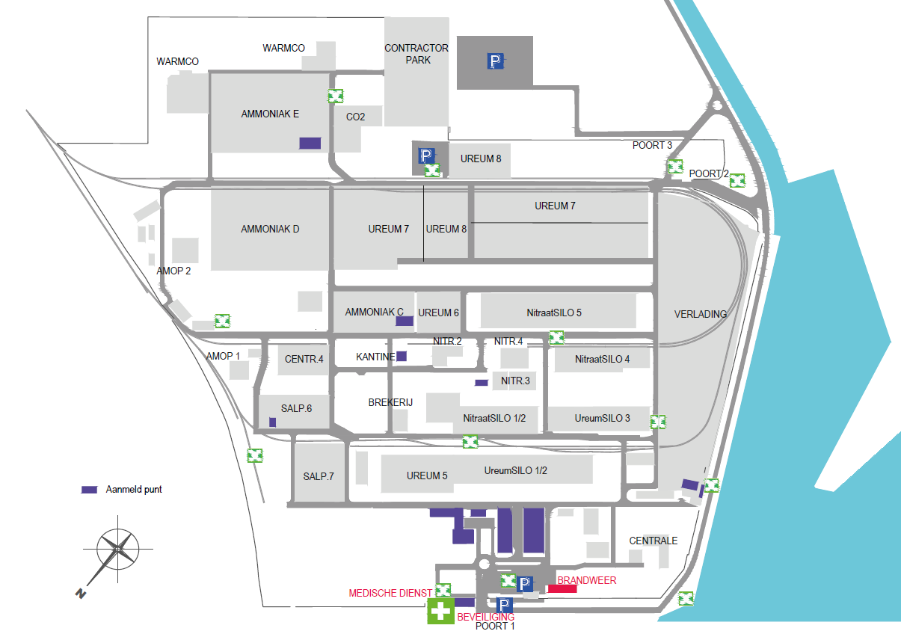
Assembly areas
Notes:
Evacuate operators in consultation with their PROCO. Operator contacts the control room to ask if they are still needed to support the PROCO (e.g. plant sweep, closing valves, etc.), before going to an assembly area.

Slide 10

End of alarm signal
End of calamity
  Fire
  Accident with hazardous substance
Emergency announcement is activated
End of alarm message via the emergency announcement system (which is repeated once).

Slide 11
Signal for announcements
Announcement via alarm system
Emergency announcement is activated
Weekly test: every Tuesday at 10:00 a.m.

Slide 12
Positions in the emergency organisation
Depending on the alarm phase:
In-company firefighting team
First aid/Health service
Security officer
Duty HESQ chief
Emergency plan coordinators
Service engineers Maintenance
PROCO/duty department head
Evacuation supervisor/Evacuators
Duty manager
Company Relief Team (= BOT team)
Yara employees, subcontractors and contractors
Notes:
In-company firefighting team
Approx. 65 firefighters
All trained as Crew A and Hazmat suit wearer.
A part of the group also trained as vehicle operators and have a category C driving licence.
In the event of a calamity, we will deploy at least 5 people (1 commander and 4 firefighters).
Everyone is trained as a Hazmat suit wearer so that we can combat an NH₃ leak (start the combat).
We have a fire engine and an intervention vehicle in the firefighter’s garage.
All these requirements have been laid down in our designation policy, which has been assigned to us by the Veiligheidsregio Zeeland (Zeeland Regional Safety Board).
First aid/Health service
Three nurses from Monday 6:00 a.m. until Friday 10:00 p.m.
Approx. 60 first-aiders who work in shifts in the absence of the medical service.
There are always two first-aiders on duty.
Security
Eight security guards who work according to a seven-shift system.
They are the first ones who are called in case of a calamity. When the telephone for emergency number 100 rings, they drop all their other activities and give it priority. The same applies to a message from the fire alarm system.
Duty HESQ chief
This could be Bart Van den Brande, Reggie van Immerseel, Hans Klandermans, Jos de Kort, Dimitri Overmeire or Peter Cnudde. In June 2019, Ewoud vd Brande and Niels Boogaerd were added to that list.
They are to be notified in case of a calamity and will then come to the location, unless this turns out to be unnecessary after consultation.
Emergency plan coordinators
These are people from the maintenance department, who are now in charge of mechanical engineering (WTB) gases and salts.
E.g. Davy Kuijpers, Marcel Riemens, Johan Huigh, Stijn Verstuyf, Martin Walhout, Rene Hamelink, Adri de Putter, Yves Baetens, etc.
They will man the coordination room. These rooms are at P1 and P2. They will be alerted from alarm phase 1 upwards.
What do they do?
Together with the duty HESQ chief, they will map out the calamity
Arrange road closures
Speak to the municipal duty officer
Make the necessary reports to the picket officer (this is specific to HESQ)
If necessary, arrange additional materials (vacuum truck, elevated platform, etc.)
Pick up the phone with number 300 and record departmental evacuations
Service engineers Maintenance
Report to the porter’s lodge at every alarm. They guide emergency services, open gates, arrange road closures, etc.
PROCO/duty department head
PROCO takes care of securing the plant, the evacuation, revocation of work permits, starting fire-fighting pumps, etc.
He can delegate these tasks to e.g. the duty department head, assistant PROCO, chief operator, etc., but he remains ultimately responsible to ensure that everything runs smoothly in the department.
The duty department head will come to help the department. He helps out in the department where necessary.
Evacuation supervisor/Evacuators
These are named on the evacuation plans of the departments, which are hung up in different locations.
In the production department, the evacuation supervisor is the PROCO, but he is allowed to delegate this task.
Duty manager
These are called in from alarm phase 2. They will come to the coordination room and take care of the necessary procedures.
E.g. speaking to the press, informing Yara int., in case of injuries asking for additional people, e.g. HR to inform family members, etc.
If the department needs a duty manager sooner, they have to call him themselves.
BOT team
This is where people from the emergency organisation can go after a calamity.
The last time this was used was in connection to the accident in Urea 7.
Who is trained for this? Frits van Zadelhof and Valentino van Overmeere.

Slide 13
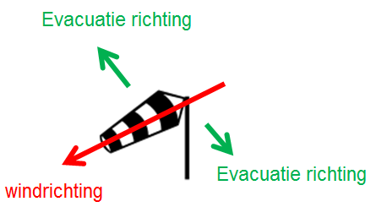
Carrying out tasks
If you don’t have a position within the emergency organisation, during every alarm, you need to:
  Keep up-to-date on the nature of the alarm:
    Where is the incident?
    What is the nature of the incident?
    What is the wind direction?
  Listen to the emergency announcement for a possible evacuation order.
  Evacuate at right angles to the wind direction.
Notes:
We do NOT normally mention the wind direction via the emergency announcement because it can be different at any location on the site (because of the high buildings, among other reasons).
When you hear an alarm, it is very important to make sure you know the wind direction on site (via a weather vane, a tower plume)
In addition, the PROCOs ALWAYS start the fire-fighting pumps of their departments.

Slide 14
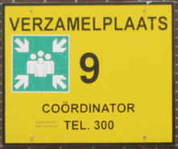
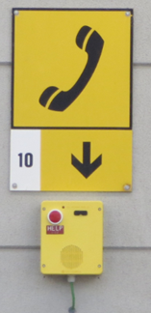
Carrying out tasks
In the event of an alarm in the department where you are present:
If possible, report to the control room, otherwise proceed to the nearest evacuation assembly area at right angles to the wind direction.
At the evacuation assembly area, report to the security officer/emergency plan coordinator via the emergency telephone (number 300), stating the following:
  Number of evacuation assembly area
  Employee/Firm
  Number of people
  Department where you work
The security officer/emergency plan coordinator reports this to the evacuation supervisor of the department concerned.
After the calamity has ended, you will return to the department.
Notes:
If you have to evacuate, the following matters are important
If possible, evacuate to the control room (if the wind direction is favourable). Contractors have to hand in their work permit and STAY in the control room. Tell them this. When everyone is inside (or you notice that there are no more people coming in or the operator indicates that he doesn’t see anyone outside anymore), call number 300 to report that the plant has been evacuated and whether everyone is present. If not, you’ll indicate who is missing. As an evacuation supervisor, you can also delegate this task to, for example, the duty department head, assistant PROCO, main operator, etc.
2. If the wind is coming from the wrong direction, evacuate to an evacuation assembly area. When you get there, use the emergency phone (yellow phone with red button) to call number 300. You will speak to an emergency plan coordinator and tell him/her:
Who you are and your company name (if applicable)
How many people are with you
What department you are from
The number of your work permit (if applicable); this is not obligated, but can sometimes be helpful
During the rest of the calamity, you need to stay there!
The emergency plan coordinator will, in turn, contact the department concerned and will report these people as present.
3. If it is also wise to leave the control room, the evacuation will start. Follow the instructions of the evacuators and the evacuation supervisors.
When the group has arrived at the evacuation assembly area, they will also call 300 to report this.
It is also very important to say if you are still missing people.
What to do with the running plants and panel operators during an evacuation?
This is a matter for the PROCO to decide. Will he trip the plant? Will a few people with breathable air be left there?
It’s up to him to decide what’s best based on the type of calamity. If necessary, he can contact the duty manager to help him make a decision.

Slide 15
Carrying out tasks
Additional measures:
  In case of Alarm phase 0 or 1 at your own department:
    Work permits are being revoked
    Close windows and external doors, stop forced ventilation
    Stay inside
  In case of Alarm phase 2 or 3:
    Work permits are being revoked on the entire site
    Close windows and external doors, stop forced ventilation
    Stay inside
In event of evacuation
  Follow the instructions of the evacuation supervisor and the evacuators in your department
    Internal assembly area
    External assembly area
Who are the evacuation supervisor and evacuators?
  Recognisable by their yellow vest
  Mentioned on evacuation plan of the department
Notes:
In case of alarm phase 2, this applies to all departments!
All work permits have been revoked.
All plants will be evacuated. Everyone stays in a control room or goes to an evacuation assembly area.
Everybody reports to number 300.
That way, traffic completely stops during alarm phase 2, with the exception of members of the emergency organisation.
How does a contractor know this?
The regular suppliers will also receive these instructions via a toolbox + this will also be explained at the suppliers’ meeting.
A minimal explanation is given in the gate instruction. The rest of the information must be provided when the work permit is issued.
What if someone from e.g. Sodexho comes in who has been in the car and hasn’t heard anything?
You stop that person and ask him/her to stay in your building.

Slide 16
Code Of Conduct
Never leave the site without signing yourself out;
Always wear the necessary PPE;
Always move at right angles to the wind direction in relation to the calamity;
Minimise internal phone traffic;
Always listen carefully to the communication via the emergency announcement system;
Always follow the instructions of members of the emergency organisation;
All communication for the benefit of the emergency organisation takes place via telephone 300;
Never go in the direction of the calamity if you are not part of the emergency organisation;
The general Code of Conduct continue to apply at all times;
From alarm phase 2:
  everyone on the site should go inside, stay inside or go to an evacuation assembly area;
  all traffic movements, with the exception of the emergency organisation, are prohibited.

Slide 17
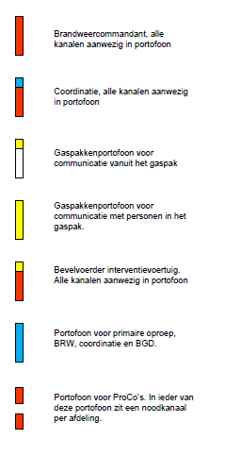
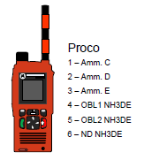
Radio telephones
In the event of an alarm, set the emergency organisation’s radio telephone to the correct (emergency) channel
For all departments, 6 is the emergency channel, except for the NU department; on those radio telephones, channel 7 is the emergency channel

